Slide 1
Clustering
Vijayalakshmi Anand

Slide 2
Density based Cluster Analysis

Slide 3
Density-Based Clustering Methods
Clustering based on density (local cluster criterion), such as density-connected points
Major features:
Discover clusters of arbitrary shape
Handle noise
One scan
Need density parameters as termination condition
Several interesting studies:
DBSCAN: Ester, et al. (KDD’96)
OPTICS: Ankerst, et al (SIGMOD’99).
DENCLUE: Hinneburg & D. Keim (KDD’98)
CLIQUE: Agrawal, et al. (SIGMOD’98) (more grid-based)

Slide 4
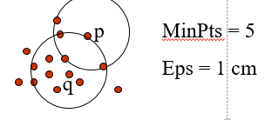
Density-Based Clustering: Basic Concepts
Two parameters:
Eps: Maximum radius of the neighbourhood
MinPts: Minimum number of points in an Eps-neighbourhood of that point
N_{Eps}(p): {q belongs to D | dist(p,q) ≤ Eps}
Directly density-reachable: A point p is directly density-reachable from a point q w.r.t. Eps, MinPts if
p belongs to N_{Eps}(q)
core point condition:
|N_{Eps} (q)| ≥ MinPts

Slide 5
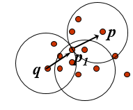
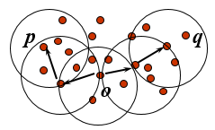
Density-reachable:
A point p is density-reachable from a point q w.r.t. Eps, MinPts if there is a chain of points p₁, …, p_{n}, p₁ = q, p_{n} = p such that p_{i+1} is directly density-reachable from p_{i}
Density-connected
A point p is density-connected to a point q w.r.t. Eps, MinPts if there is a point o such that both, p and q are density-reachable from o w.r.t. Eps and MinPts

Slide 6
DBSCAN
Density = number of points within a specified radius (Eps)
A point is a core point if it has more than a specified number of points (MinPts) within Eps
These are points that are at the interior of a cluster
A border point has fewer than MinPts within Eps, but is in the neighborhood of a core point
A noise point is any point that is not a core point or a border point.

Slide 7
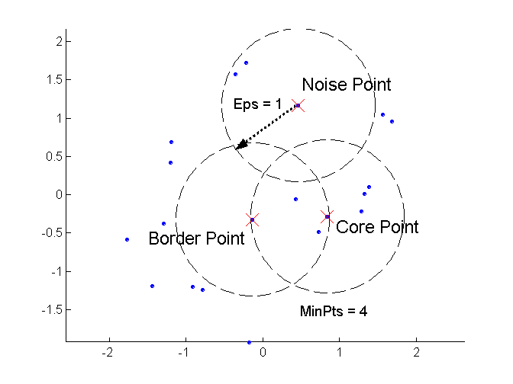
DBSCAN: Core, Border, and Noise Points

Slide 8
DBSCAN Algorithm
Input: N objects to be clusters and global parameters ɛ and MinPts. Output: Clusters of objects
1.Arbitrary select a point P. 2. Retrieve all point density reachable from P wrt ɛ and MinPts. 3.If P is a core point a cluster is formed. 4. If P is a border point, then there is no point that is density-reachable and DBSCAN moves to the next point. 5. This process is continued until all the points are processed.

Slide 9
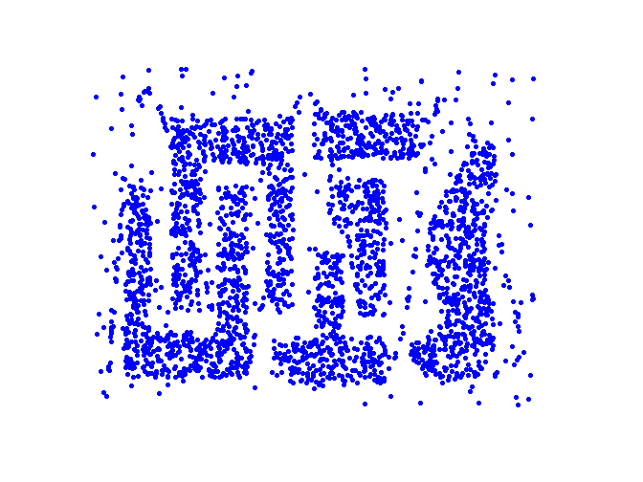
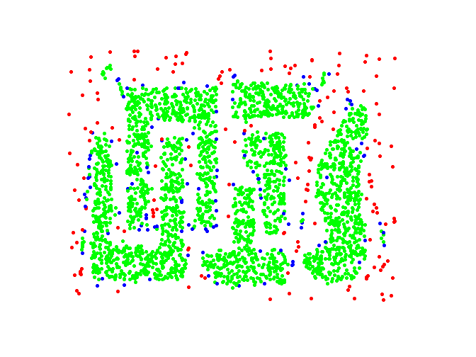
DBSCAN: Core, Border and Noise Points
Original Points
Point types: core, border and noise
Eps = 10, MinPts = 4

Slide 10
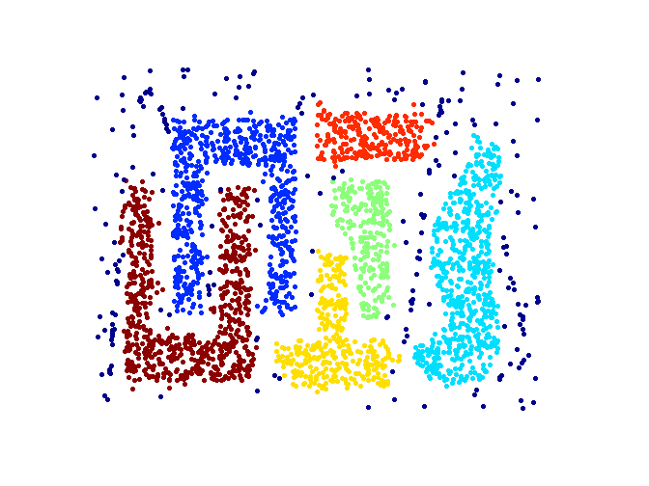
When DBSCAN Works Well
Original Points
Clusters
Resistant to Noise
Can handle clusters of different shapes and sizes

Slide 11
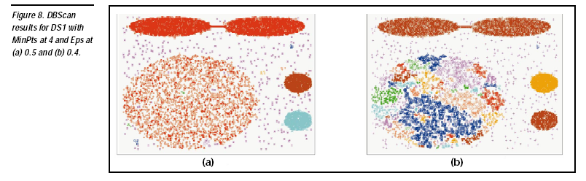
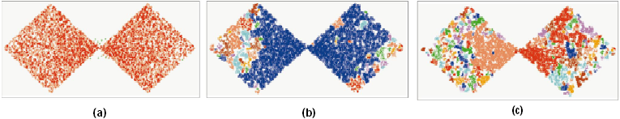

DBSCAN: Sensitive to Parameters
DBSCAN does not work well for
Varying densities
High-dimensional data

Slide 12
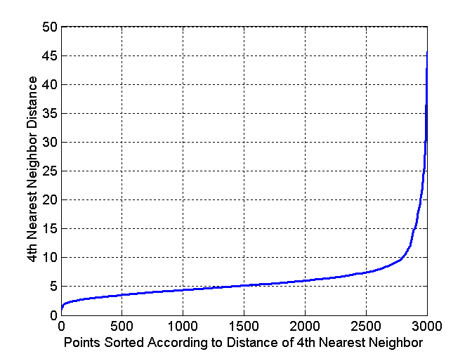
DBSCAN: Determining EPS and MinPts
Idea
for points in a cluster, their k^{th} nearest neighbors are at roughly the same distance
Noise points have the k^{th} nearest neighbor at farther distance
plot sorted distance of every point to its k^{th} nearest neighbor

Slide 13
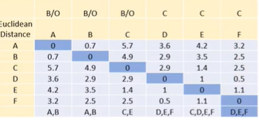
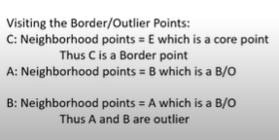
Example

Slide 14
OPTICS algorithm
Ordering points to identify the clustering structure (OPTICS) is an algorithm for finding density-based clusters
OPTICS overcomes the (DBSCAN) problem of detecting meaningful clusters in data of varying density
Points of the dataset are (linearly) ordered such that spatially closest points become neighbors. A special distance is plotted for each point

Slide 15
Cluster Validation

Slide 16
Cluster Validity
For supervised classification we have a variety of measures to evaluate how good our model is
Accuracy, precision, recall
For cluster analysis, the analogous question is how to evaluate the “goodness” of the resulting clusters?
But “clusters are in the eye of the beholder”!
Then why do we want to evaluate them?
To avoid finding patterns in noise
To compare clustering algorithms
To compare two sets of clusters
To compare two clusters

Slide 17
Clusters found in Random Data
Random Points
DBSCAN
K-means
Complete Link

Slide 18
Different Aspects of Cluster Validation
Determining the clustering tendency of a set of data, i.e., distinguishing whether non-random structure actually exists in the data.
Comparing the results of a cluster analysis to externally known results, e.g., to externally given class labels.
Evaluating how well the results of a cluster analysis fit the data without reference to external information.
- Use only the data
Comparing the results of two different sets of cluster analyses to determine which is better.
Determining the ‘correct’ number of clusters.
For 2, 3, and 4, we can further distinguish whether we want to evaluate the entire clustering or just individual clusters.

Slide 19

Clustering Tendency
All clustering algorithms find some clusters, whether data has natural clusters or not.
We need a mechanism to check if at least some clusters are of good quality
.
Hopkins Statistic : Use p points from data and generate a set of p random points in data space. Let u_{i} be nearest neighbor distances in generated data and w_{i} be nearest neighbor distances in supplied data. Hopkin statistic H is defined as
H is closer to 0 => data is highly clustered;
H is closer to 0.5 => data is randomly distributed in data space

Slide 20
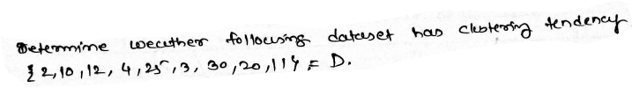
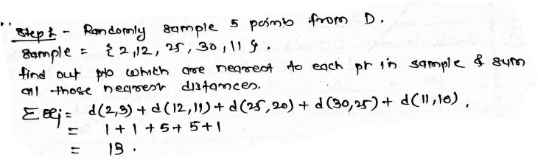
Example

Slide 21
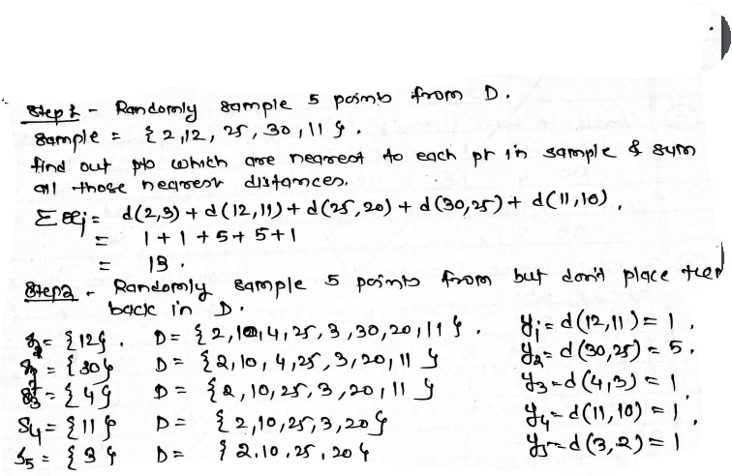

Slide 22
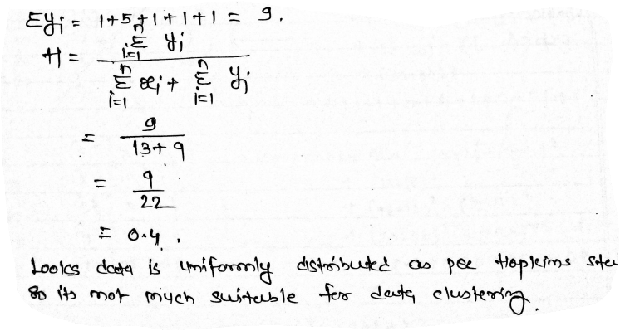

Slide 23
Evaluation measures for Cluster Validity
Unsupervised Measures without resort to external information, also referred internal indices
Cluster Cohesion (compactness, tightness)
Cluster Separation (isolation)
Supervise Measures match the clustering output to some external structure, also referred external indices
Purity
Entropy
Jacoord coefficient
Relative - compare different clustering outcomes. can be based on supervised or unsupervised measures, e.g. two K-means clustering outputs can be compared using either SSE or entropy.

Slide 24
Internal Measures: Cohesion and Separation
Cluster Cohesion: Measures how closely related are objects in a cluster
Cohesion is measured by the within cluster sum of squares (SSE)
Cluster Separation: Measure how distinct or well-separated a cluster is from other clusters
Separation is measured by the between cluster sum of squares
Where |C_{i}| is the size of cluster i and ci is the centroid of the whole data set

Slide 25
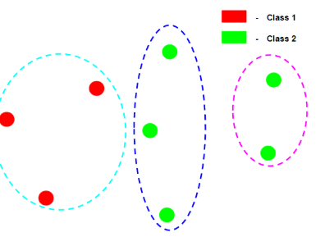
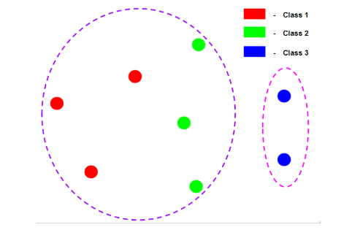
Measuring Clustering Quality: Extrinsic Methods
Clustering quality measure: Q(C, C_{g}), for a clustering C given the ground truth C_{g}.
Q is good if it satisfies the following 4 essential criteria
Cluster homogeneity
Completeness
Rag bag
Small cluster preservation
25

Slide 26
Classification-based Measures of Cluster Validity
Precision: The fraction of a cluster that consists of objects of a specified class. The precision of cluster i with respect to a class j is precision(i,j) = p_{ij}
Recall: The extent to which a cluster contains all objects of a specified class. The recall of cluster i with respect to class j is recall(i, j) = m_{ij}/m_{j} where m_{j} is the number of objects in class j.
F-measure: A combination of both precision and recall that measures the extent to which a cluster contains only objects of a particular class and all objects of that class. The F-measure of cluster i with respect to class j is
F(i,j) = (2*precision(i,j)*recall(i,j))/(precision(i,j)+recall(i,j))

Slide 27
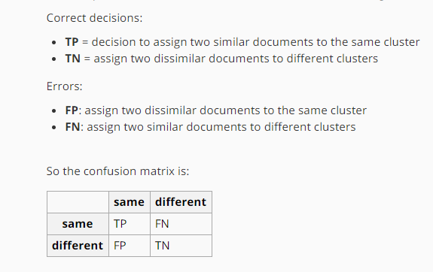

Slide 28
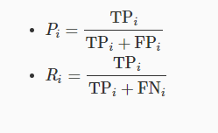
External Measures of Cluster Validity: Precision/Recall
Cluster | Entertainment | Financial | Foreign | Metro | National | Sports | Totals
1 | 3 | 5 | 40 | 506 | 96 | 27 | 677
2 | 4 | 7 | 280 | 29 | 39 | 2 | 361
3 | 1 | 1 | 1 | 7 | 4 | 671 | 685
4 | 10 | 162 | 3 | 119 | 73 | 2 | 369
5 | 331 | 22 | 5 | 70 | 13 | 23 | 464
6 | 5 | 358 | 12 | 212 | 48 | 13 | 648
Total | 354 | 555 | 341 | 943 | 273 | 738
K-means clustering result for a newspaper articles document data set
For Cluster 1 and Metro class,
Precision = 506/677 = 0.75
Recall = 506/943 = 0.54
F-value = 0.63
For Cluster 3 and Sports class,
Precision = 671/685 = 0.98
Recall = 671/738 = 0.91
F-value = 0.94

Slide 29
Final Comment on Cluster Validity
“The validation of clustering structures is the most difficult and frustrating part of cluster analysis.
Without a strong effort in this direction, cluster analysis will remain a black art accessible only to those true believers who have experience and great courage.”
Algorithms for Clustering Data, Jain and Dubes

Slide 30
Application
1 Business Problem: A bank wants to group loan applicants into high/medium/low risk based on attributes such as loan amount, monthly installments, employment tenure, the number of times the applicant has been delinquent in other payments, annual income, debt to income ratio etc.

Slide 31
Application
2.Business Problem: The enterprise wishes to organize customers into groups/segments based on similar traits, product preferences and expectations. Segments are constructed based on customer demographic characteristics, psychographics, past behavior and product use behavior.

Slide 32
Other Distinctions Between Sets of Clusters
Exclusive versus non-exclusive
In non-exclusive clustering, points may belong to multiple clusters.
Can represent multiple classes or ‘border’ points
Fuzzy versus non-fuzzy
In fuzzy clustering, a point belongs to every cluster with some weight between 0 and 1
Weights must sum to 1
Probabilistic clustering has similar characteristics
Partial versus complete
In some cases, we only want to cluster some of the data
Heterogeneous versus homogeneous
Cluster of widely different sizes, shapes, and densities

Slide 33
Types of Clusters
Clusters can be of many types:
Well-separated clusters
Center-based clusters
Contiguous clusters
Density-based clusters

Slide 34
Types of Clusters: Well-Separated
Well-Separated Clusters:
3 well-separated clusters

Slide 35
Types of Clusters: Center-Based
Center-based
A cluster is a set of objects such that an object in a cluster is closer (more similar) to the “center” of a cluster, than to the center of any other cluster
4 center-based clusters

Slide 36
Types of Clusters: Contiguity-Based
Contiguous Cluster (Nearest neighbor or Transitive)
A cluster is a set of points such that a point in a cluster is closer (or more similar) to one or more other points in the cluster than to any point not in the cluster.
8 contiguous clusters

Slide 37
Types of Clusters: Density-Based
Density-based
A cluster is a dense region of points, which is separated by low-density regions, from other regions of high density.
Used when the clusters are irregular or intertwined, and when noise and outliers are present.
6 density-based clusters

Slide 38
Types of Clusters: Conceptual Clusters
Shared Property or Conceptual Clusters
Finds clusters that share some common property or represent a particular concept.
.
2 Overlapping Circles

Slide 39
Thank you ☺
Q&A
Suggestions / Feedback

